Slide 1
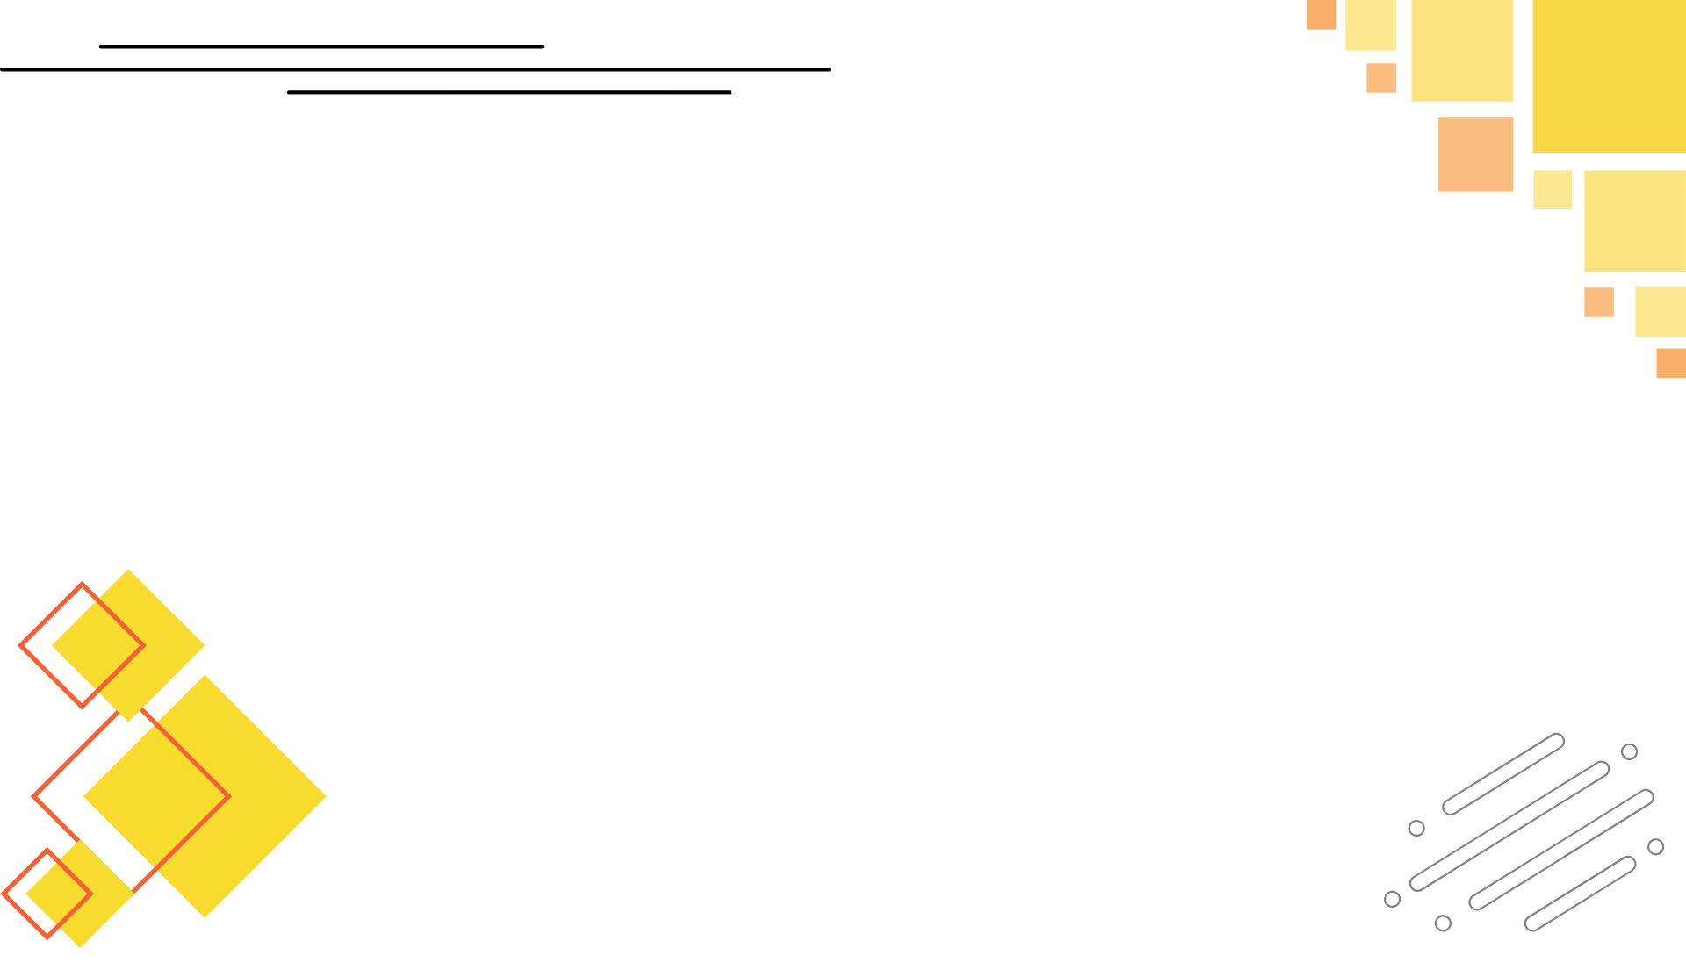



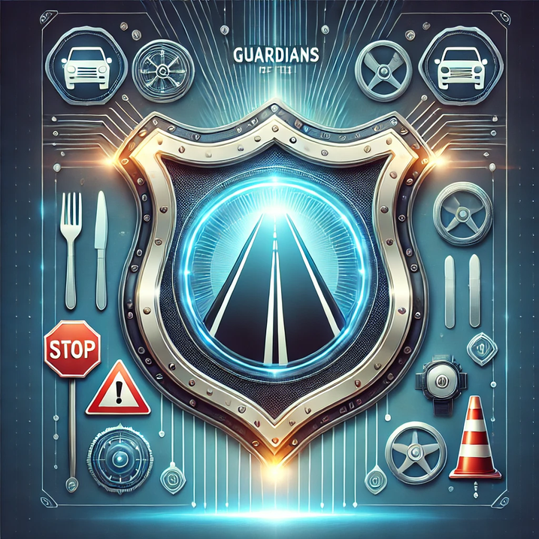
Guardians of the Road
Team: Undefined Pair

Slide 2
Track - SOFTWARE
Topic: Open Innovation
Project: RakhshaMarg
“The best way to predict the future is to create it. With Rakshamarg, we are creating a future where every journey is a safe one.”

Slide 3
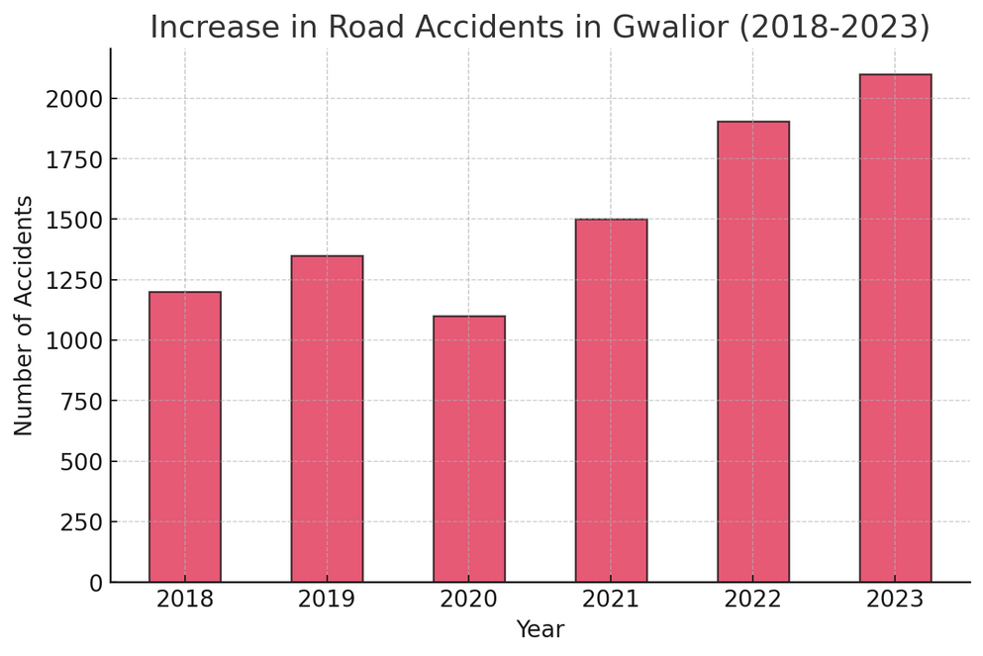
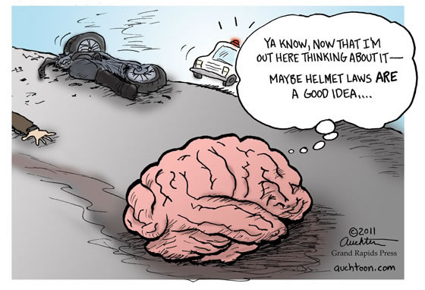
PROBLEM STATEMENT
In Gwalior, road safety is a significant concern. In the first eleven months of 2022, the city recorded 1,906 road accidents, resulting in 305 fatalities and 1,398 serious injuries. ​
A substantial portion of these accidents occurred at identified high-risk areas, including Sikroda Trijunction, Jaurasi Valley, Simariya Tekri, Antari Kalyan Square, and the road in front of Anand Trust Hospital. ​
These statistics underscore the urgent need for innovative solutions to enhance road safety, reduce accidents, and promote responsible behavior among commuters in Gwalior.
No platform currently provides route-specific accident risk insights dynamically based on live user location.
A smart, proactive, and community-driven solution is needed to alert users and improve road safety.
Image Source: MoRth & MPTD

Slide 4
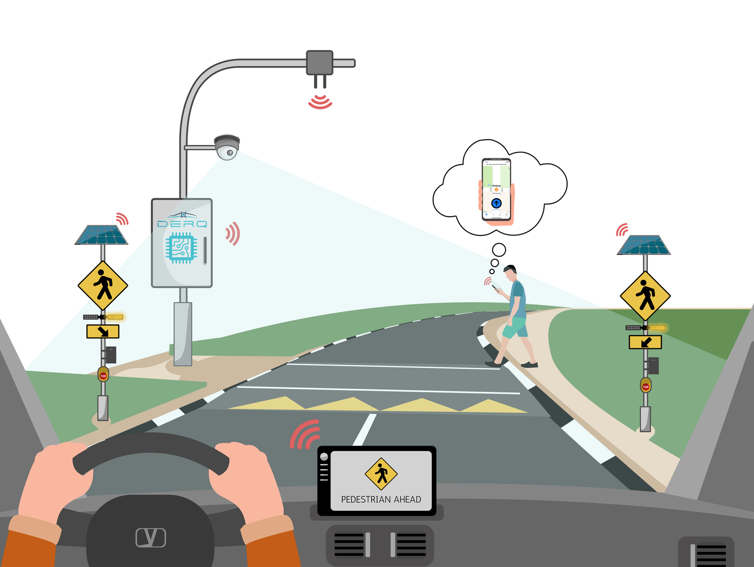
PROPOSED SOLUTION
🚦 Rakshamarg – A road safety companion app inspired by Aarogya Setu that helps users:
Identify Nearby Accident Hotspots – Just like Aarogya Setu tracked COVID cases, Rakshamarg alerts users about accident-prone areas.
Route Customization Based on Safety Preferences – Users can choose:
Shortest Route (may contain hotspots)
Longer, Safer Route (minimal or no hotspots)
Dynamic Hotspot Risk Assessment – Risk levels update as per real-time location.
Live Traffic & Accident Insights – Displays past accident data and real-time congestion levels at each hotspot.
User Feedback & Community Reporting – Users can mark new risky areas, like sharp turns or high-speed zones.

Slide 5
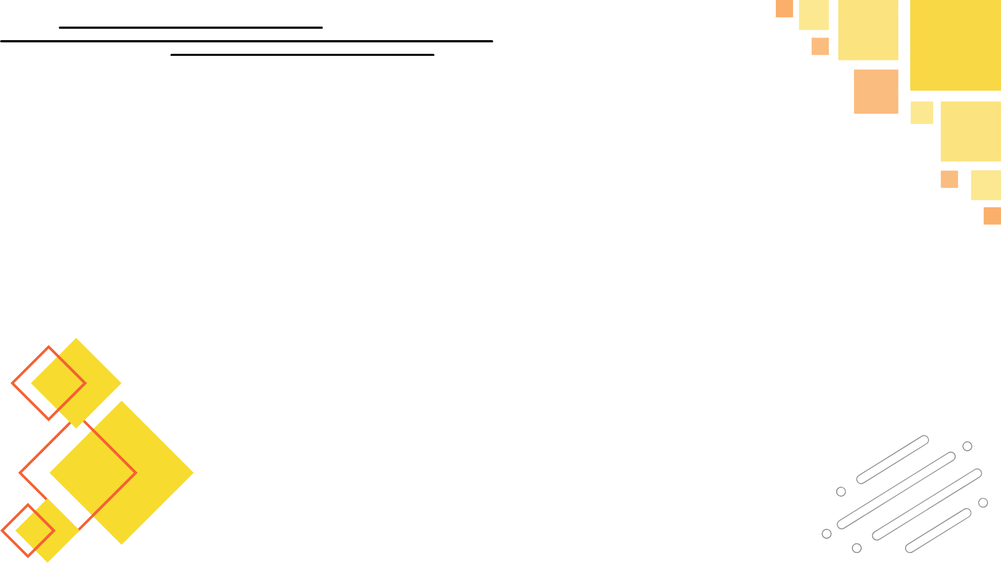


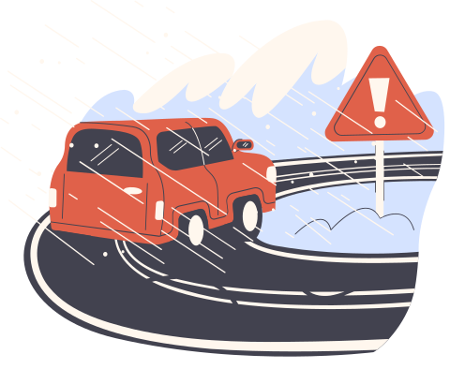


FLOWCHART/DIAGRAM
User signup
Route selection
Hotspot detection
Feedback integration
Real-time updates

Slide 6
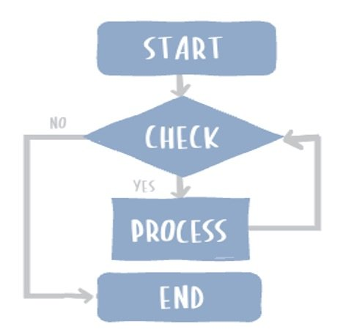
FLOWCHART EXPLAINATION:
Our Rakshamarg app follows a structured process to provide real-time accident hotspot alerts and safer route recommendations. Below is a step-by-step breakdown:
User Registration & Route Preference:
Users sign up and select their route preference:
Shorter Rout (faster but may have accident hotspots).
Longer & Safer Route (minimal or no hotspots).
Route Selection & Risk Assessment:
The user enters the start and destination points.
The app analyzes real-time accident and traffic data to suggest the safest possible route.
The route map shows hotspots and their risk levels.
3. Real-Time Risk Alerts:
As the user moves, the app dynamically updates risk levels for upcoming hotspots.
Alerts are based on past accident data, current traffic density, and weather conditions.
4. Traffic Insights & User Feedback:
a. The app provides traffic updates and accident risk analysis at each hotspot.
b. Users can report new hazards like sharp turns or blind spots, improving
future accuracy.
c. The system learns from user reports and real-time data to improve route
safety over time.

Slide 7

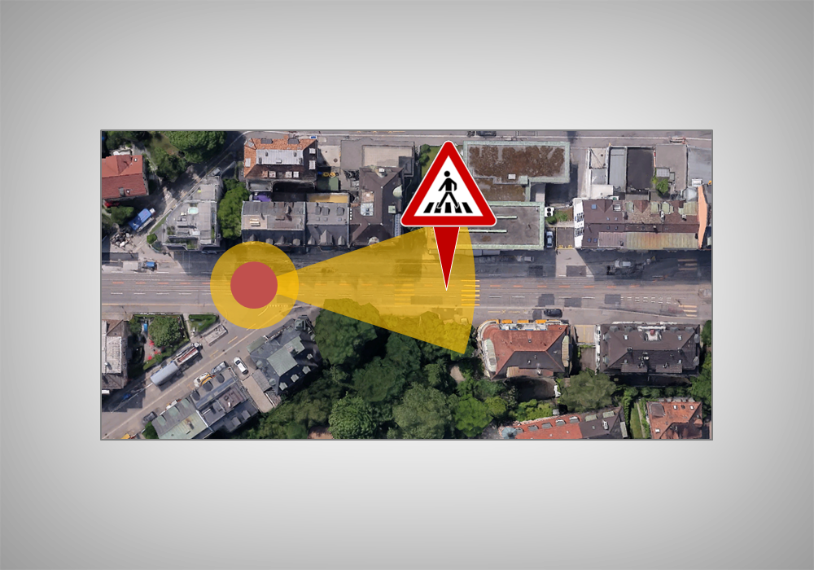
FEATURES AND NOVELTY
Personalized Route Planning –
Users can opt for safety-first routing, unlike regular GPS apps.
Live Hotspot Alerts –
Dynamic updates based on user location, ensuring real-time safety insights.
Accident Risk Predictions –
AI-driven risk assessment at each hotspot based on historical & live data.
Community-Driven Reporting –
Users contribute by adding missing hazardous locations.
Traffic Density & Risk Insights –
Helps users anticipate accident-prone areas ahead.

Slide 8
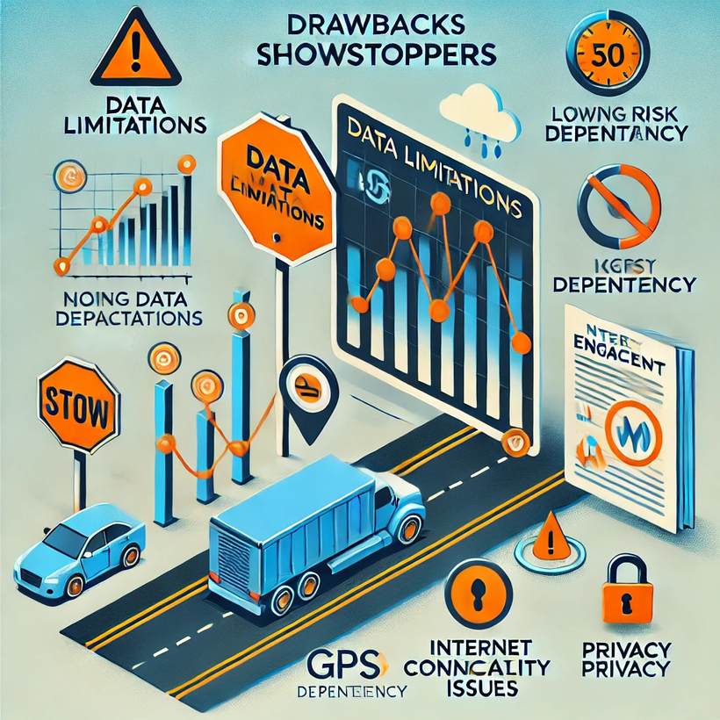
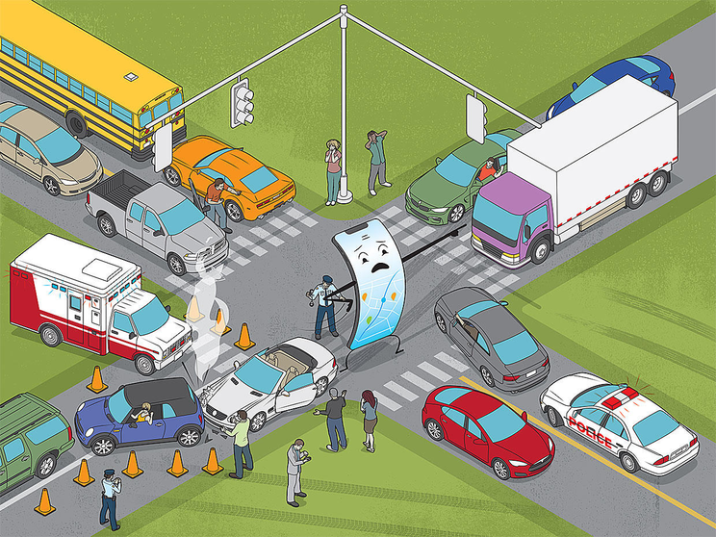
DRAWBACK AND SHOWSTOPPERS
🚧 Data Accuracy & Availability – Needs reliable
accident data and user-generated inputs.
🚧 User Adoption – Encouraging drivers to actively use
the app and provide feedback.
🚧 Live Traffic Integration – Requires access to real-
time traffic and accident reports.
🚧 Government & Authority Support – Collaboration
with city traffic departments for large-scale
deployment.

Slide 9
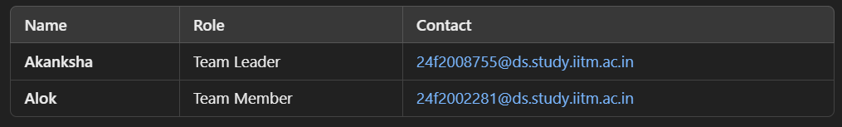
Undefined Pair
Rakshamarg – Your Safe Route, Every Time!

Slide 10

Making Roads Safer, One Route at a Time!
THANK YOU

